Slide 1
Special Sales order types
Lecturer: Tran Thi Anh

Slide 2
Cash Sales
Cash sales is an order type for when the customer orders, picks up and pays for the goods immediately.
The delivery is processed as soon as the order has been entered.
A cash invoice can be printed immediately from the order and billing is related to the order. The current date as the date for delivery and billing.
Receivables do not occur for the customer as they do for rush or standard orders, because the invoice amount is posted directly to a cash account.
Notes:
Bán hàng bằng tiền mặt là một loại đơn đặt hàng khi khách hàng đặt hàng, nhận và trả tiền cho hàng hóa ngay lập tức.
Giao hàng được xử lý ngay sau khi đơn hàng đã được nhập.
Hóa đơn tiền mặt có thể được in ngay lập tức từ đơn đặt hàng và hóa đơn có liên quan đến đơn hàng. Ngày hiện tại là ngày giao hàng và thanh toán.
Các khoản phải thu không xảy ra cho khách hàng khi họ thực hiện các đơn đặt hàng gấp hoặc tiêu chuẩn, vì số tiền hóa đơn được gửi trực tiếp vào tài khoản tiền mặt.

Slide 3
Cash Sales
Document type: BV
Delivery happens immediately: Delivery type BV
Order related invoice type: BV
Sales order is used as an Reference document in Financial Accounting

Slide 4
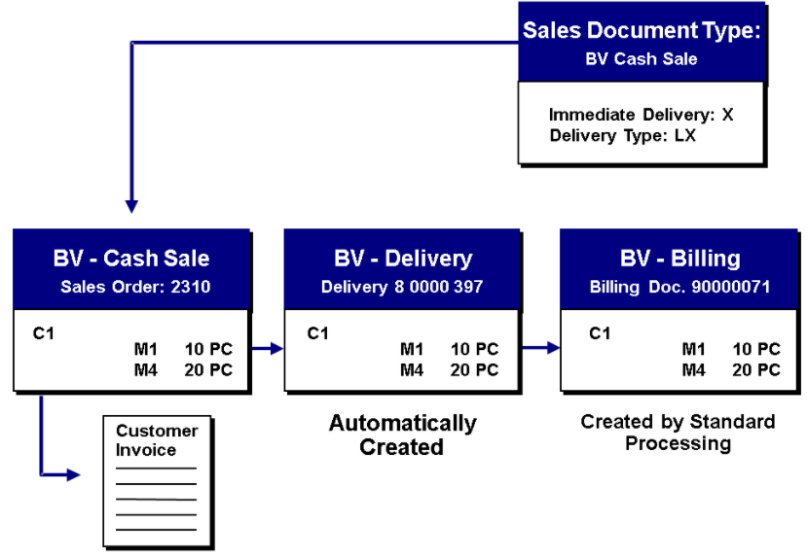

Slide 5
Rush orders
In rush orders, your customer picks up the product immediately, or you deliver the product to the customer on the same day on which the order was made.
The system automatically creates a delivery for a rush order.
However, the billing document is created at a later time.
Document type: RO
Delivery happen immediately: Delivery type: LF
Invoice type: F2
Notes:
Trong các đơn đặt hàng gấp, khách hàng của bạn nhận sản phẩm ngay lập tức hoặc bạn giao sản phẩm cho khách hàng vào cùng ngày mà đơn hàng được thực hiện.
Hệ thống tự động tạo một giao hàng cho một đơn đặt hàng gấp.
Tuy nhiên, chứng từ thanh toán được tạo ra sau đó.
Loại tài liệu: RO
Giao hàng ngay lập tức: Loại giao hàng: LF
Loại hóa đơn: F2

Slide 6
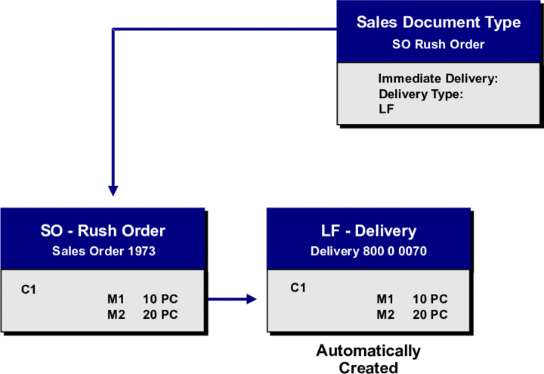

Slide 7
Scenarios
You attend the road show of nokia's new product. You liked the product and you brought the product then and there.
Doctor wants a bottle of blood from Blood Bank for emergency case. In this case delivery will be immediate and billing will be done on regular terms. It is for regular customers.

Slide 8

Flow of The Product
9am- 6pm
Pre-seller goes on his route and books the orders
9am-6pm
Order is registered on the server through GPRS on the spot
6pm-11pm
Order is processed
Load sheet is released
11pm-6am
Loading the vehicles is done by the C&F people
On a tablet or Blackberry

Slide 9
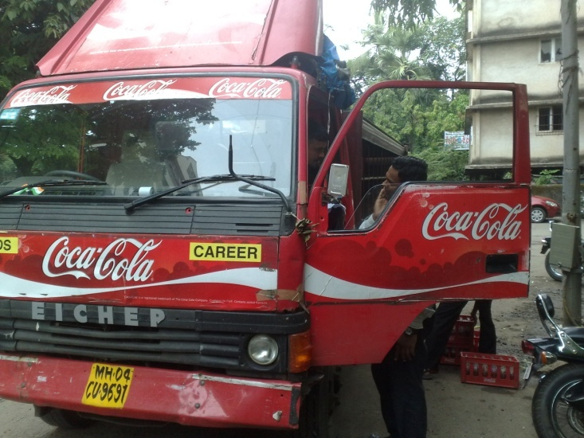
Contd.
6am-9.30am
First vehicles leaves at 6am
9.30am-8.30pm
Product delivery
8.30pm-11pm
Trucks return to depot
11pm
Records are tallied
All vehicles leave by 9.30am
Empty bottles are collected
Unloading takes place
Cash submission
Only cash except for a few
Cannot take more than order

Slide 10
Difference Between Cash Sales and Rush Order
1) Cash sale : in this delivery automatically happen when you save the sales order. And the system prints a document that is used as an invoice for the customer.
Rush order. Here also delivery automatically happen when you save the sales order. But the difference is you can send invoice after some time but the delivery should happen immediately.
-> If you go to any super market first, you pick up the item and then pay the bill and then you will get the bill, this process is cash sales.

Slide 11
Difference Between Cash Sales and Rush Order
2) Cash sales triggers cash a/c whereas in RO customers account is debited.
3) Cash sales is not relevant for availability check as you will be picking the goods whereas RO is relevant for availability check.
The cash sale can only be billed if the order quantity is the same as the goods issue quantity. If this is not the case, you need to adjust the cash sale document so that the delivered quantity and the quantity to be billed match.

